Slide 1
Beth yw Dysgu Heb ei Achredu?
Mae Dysgu Heb ei Achredu yn canolbwyntio ar anghenion y dysgwr unigol.
Y nod yw paratoi ein dysgwyr i allu canfod eu lle yn eu cymuned, i gyfrannu at fyd gwaith ac i feithrin y sgiliau i fod mor annibynnol â phosibl.
Defnyddir dull sy'n canolbwyntio ar yr unigolyn i gynllunio'r rhaglen drwy osod targedau unigol.
Mae ein dysgwyr yn dilyn rhaglen dysgu ac addysgu sy'n seiliedig ar Bedwar Piler Sgiliau Byw'n Annibynnol ac Adeiladu Sgiliau.

Slide 2
What is Non Accredited Learning (NAL)?
NAL focuses on the needs of the individual learner.
The aim is to prepare our learners to find their place in their community, contribute to the world of work and develop skills to be as independent as they can.
A person centred approach is used to plan the programme through individualised targets.
Our learners follow a teaching and learning programme that is built on the Four Pillars of ILS and Skillbuild.

Slide 3
CYDNABOD A CHOFNODI CYNNYDD A CHYFLAWNIAD (RARPA) ⁠
Llwybr dysgu wedi'i deilwra yw RARPA sy'n defnyddio'r 5 elfen a ganlyn.
Cytuno ar lwybr dysgu personol y dysgwr ar ddechrau'r rhaglen - Beth yw'r nod tymor hir? Pam fod y dysgwr yn dod i'r coleg?
⁠Cynnal asesiad cychwynnol cadarn, a sefydlu’r man cychwyn ar sail cyfnod asesu o hanner tymor.
⁠Nodi amcanion dysgu addas sy'n cynnig heriau priodol ar sail targedau perthnasol ac ystyrlon i'r dysgwr.
Caiff tystiolaeth o ddysgu ei olrhain yn glir ac yn briodol (asesiad ffurfiannol), gan gyfeirio at amcanion dysgu a'i adolygu yn y dosbarth/tiwtorialau personol.
Adolygiad o berfformiad cyffredinol y dysgwr: dangos dilyniant, cyflawniad ar ddiwedd y rhaglen, a chyflawniad cymwysterau fel y bo'n briodol.

Slide 4
RARPA (Recognising and Recording Progress and Achievement)
RARPA is a customised learning journey using the following 5 elements.
Agree the personalised learner journey aim at the start of the programme – What is the long term goal? Why is the learner coming to college?
Undertake a robust initial assessment and establish the starting point based on a half term period of assessment.
Identify appropriately challenging learning objectives based on targets that are relevant and meaningful for the learner.
Evidence of learning is clearly and appropriately tracked (formative assessment), referenced to learning objectives and reviewed in class/personal tutorial.
Review of the overall performance of the learner: showing progression, achievement at the end of programme, and achievement of qualifications as appropriate.

Slide 5
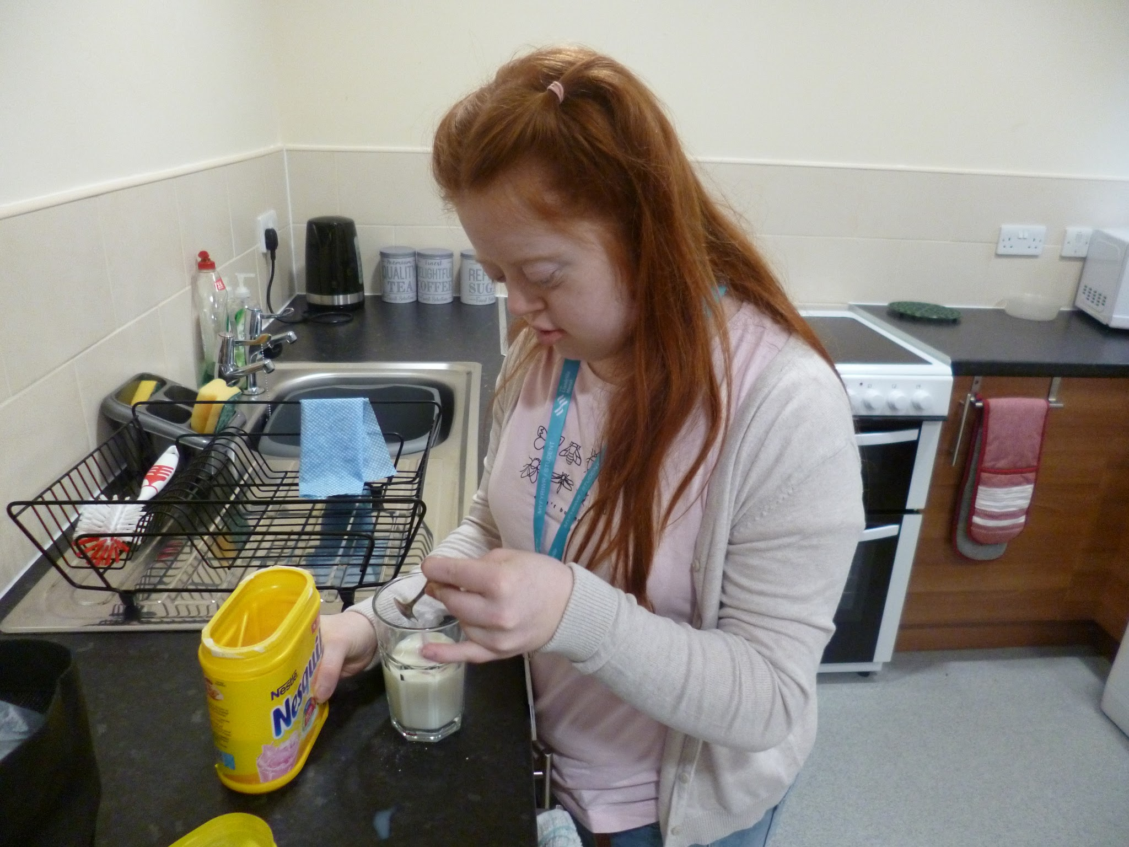
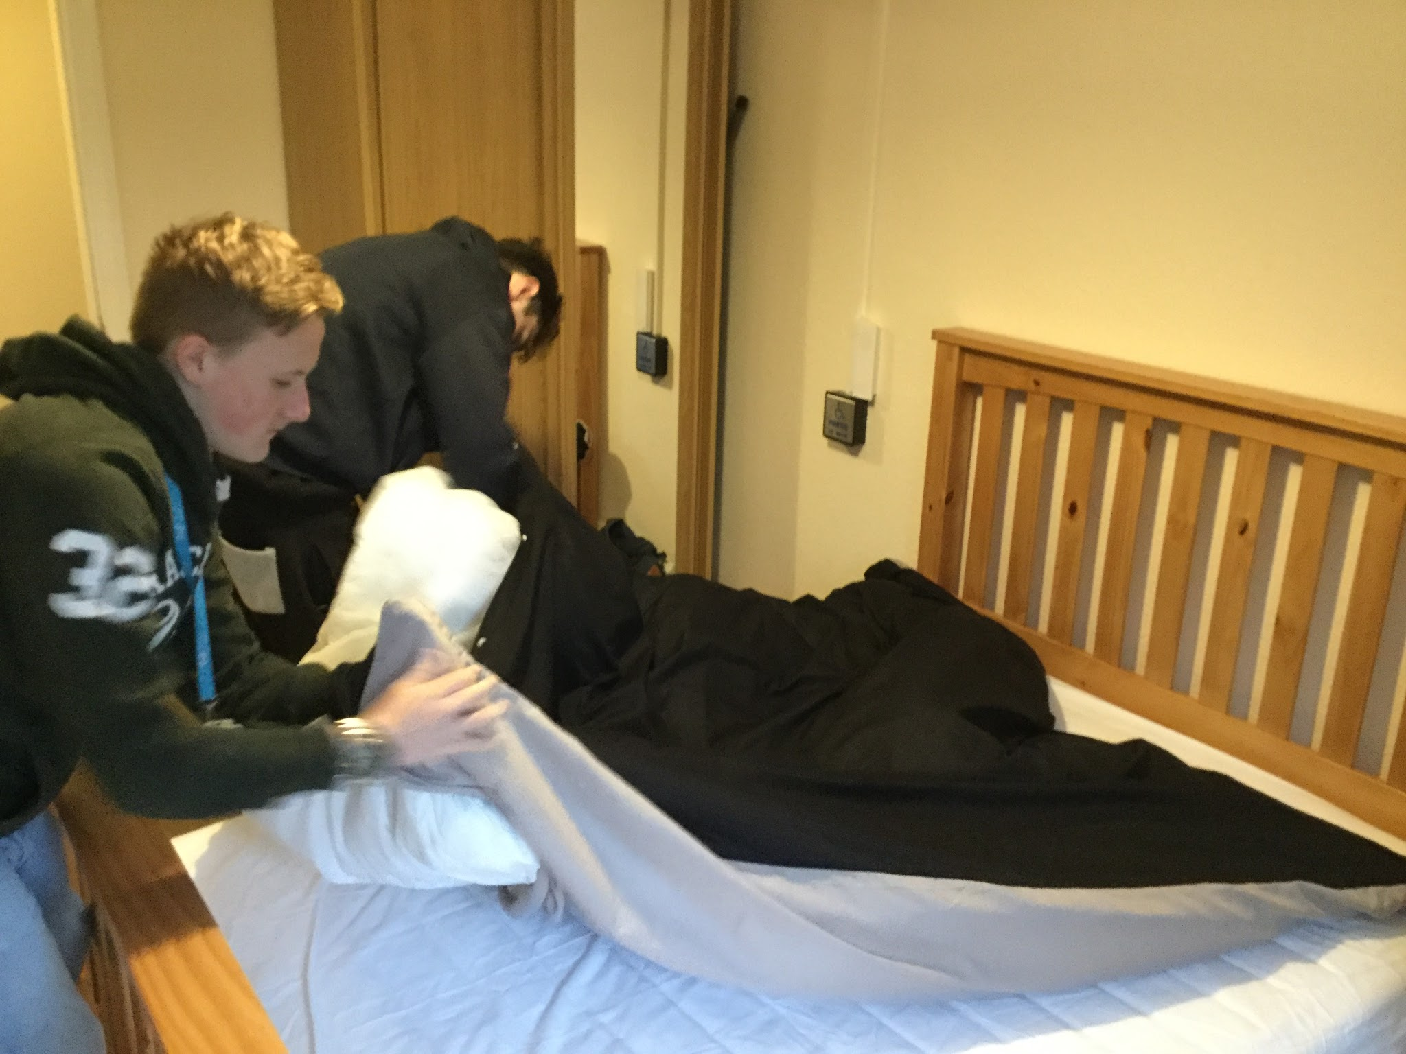
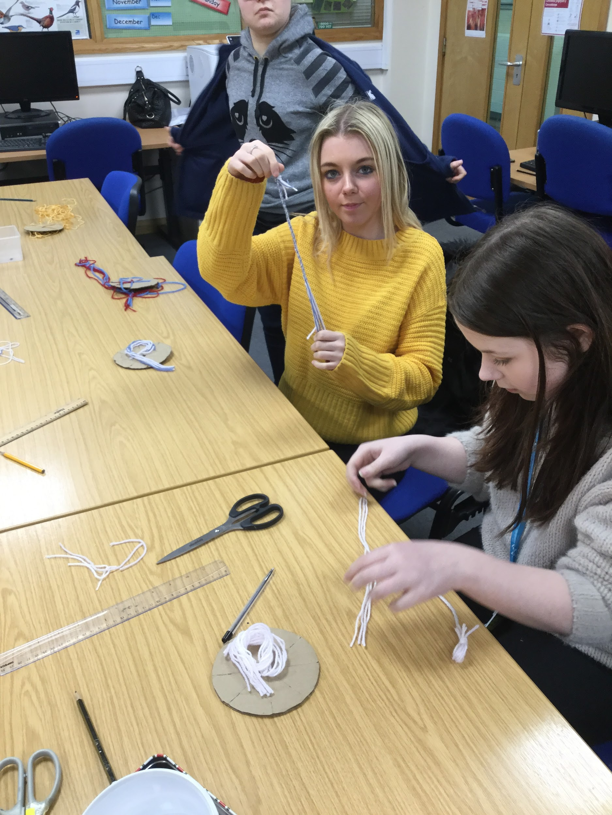
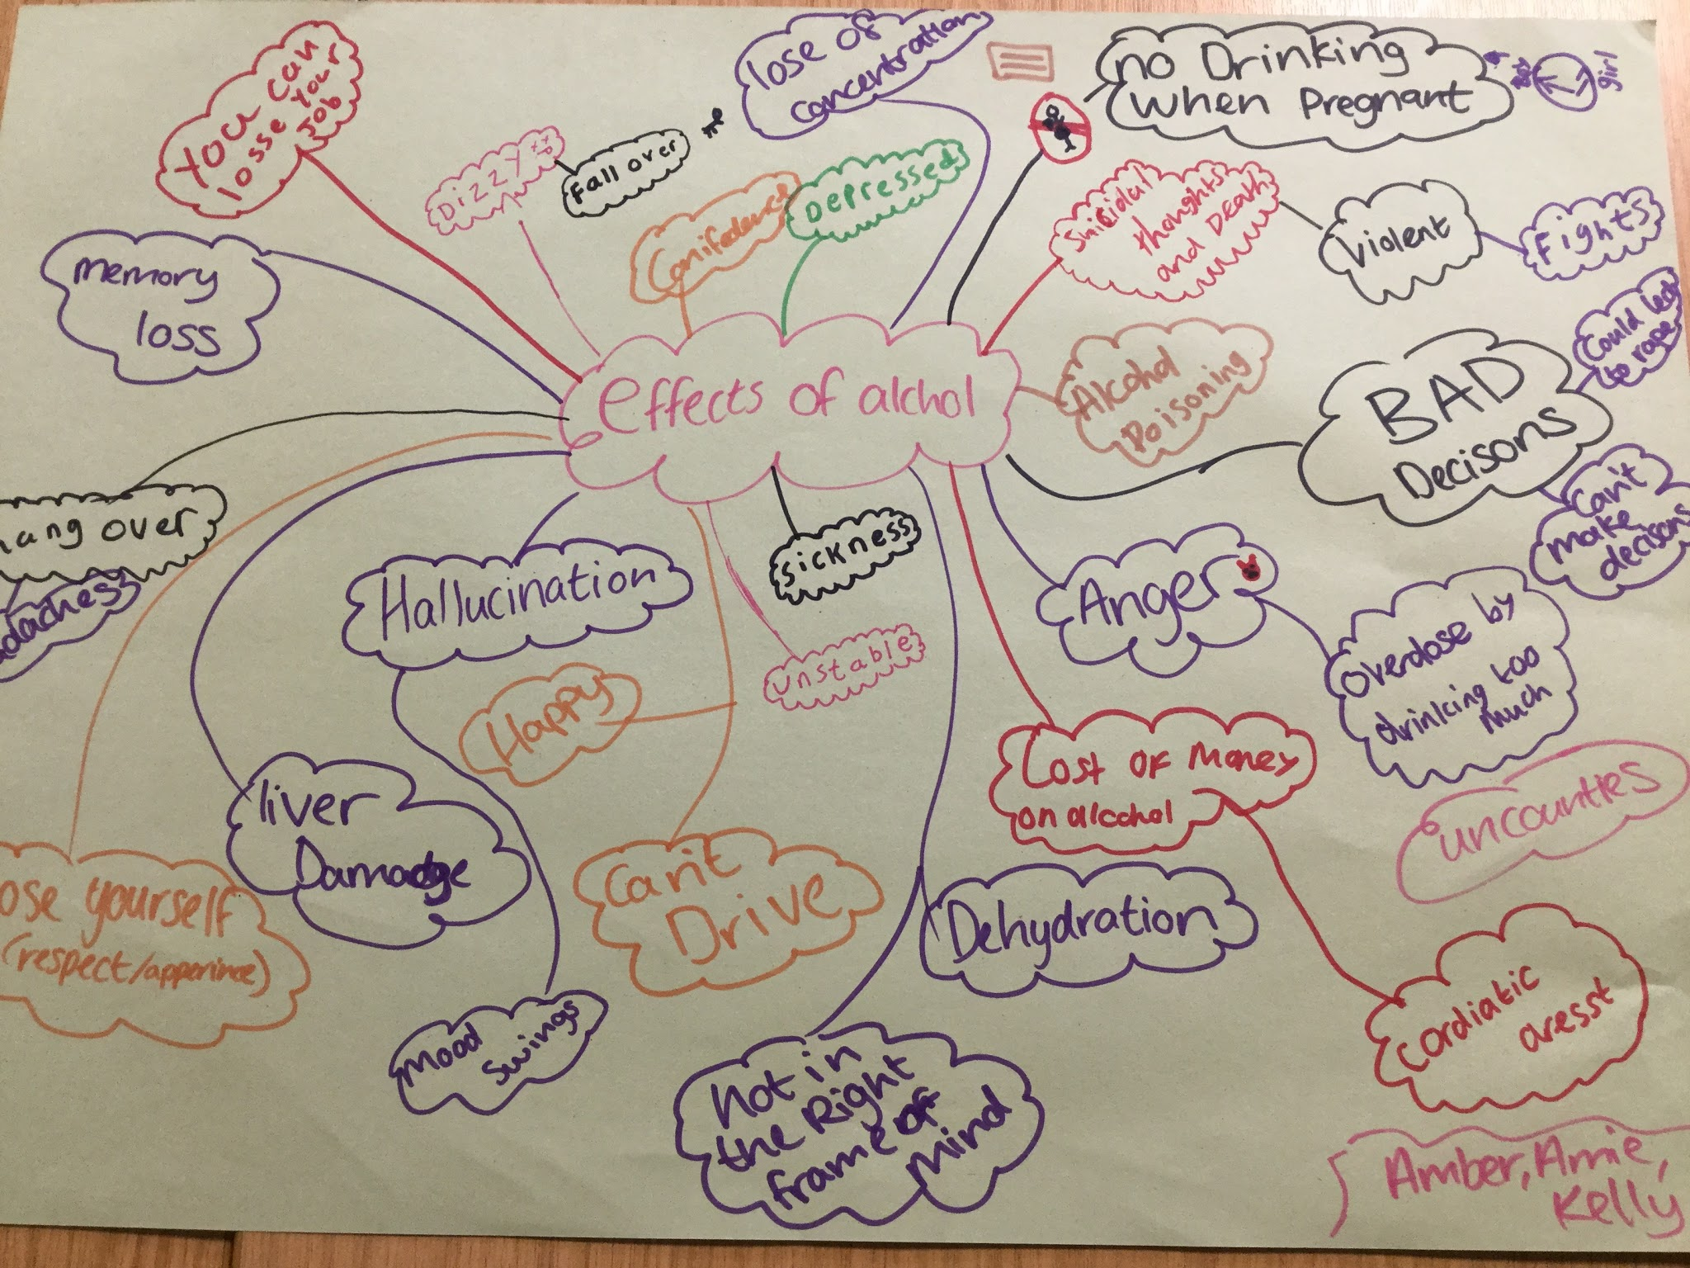
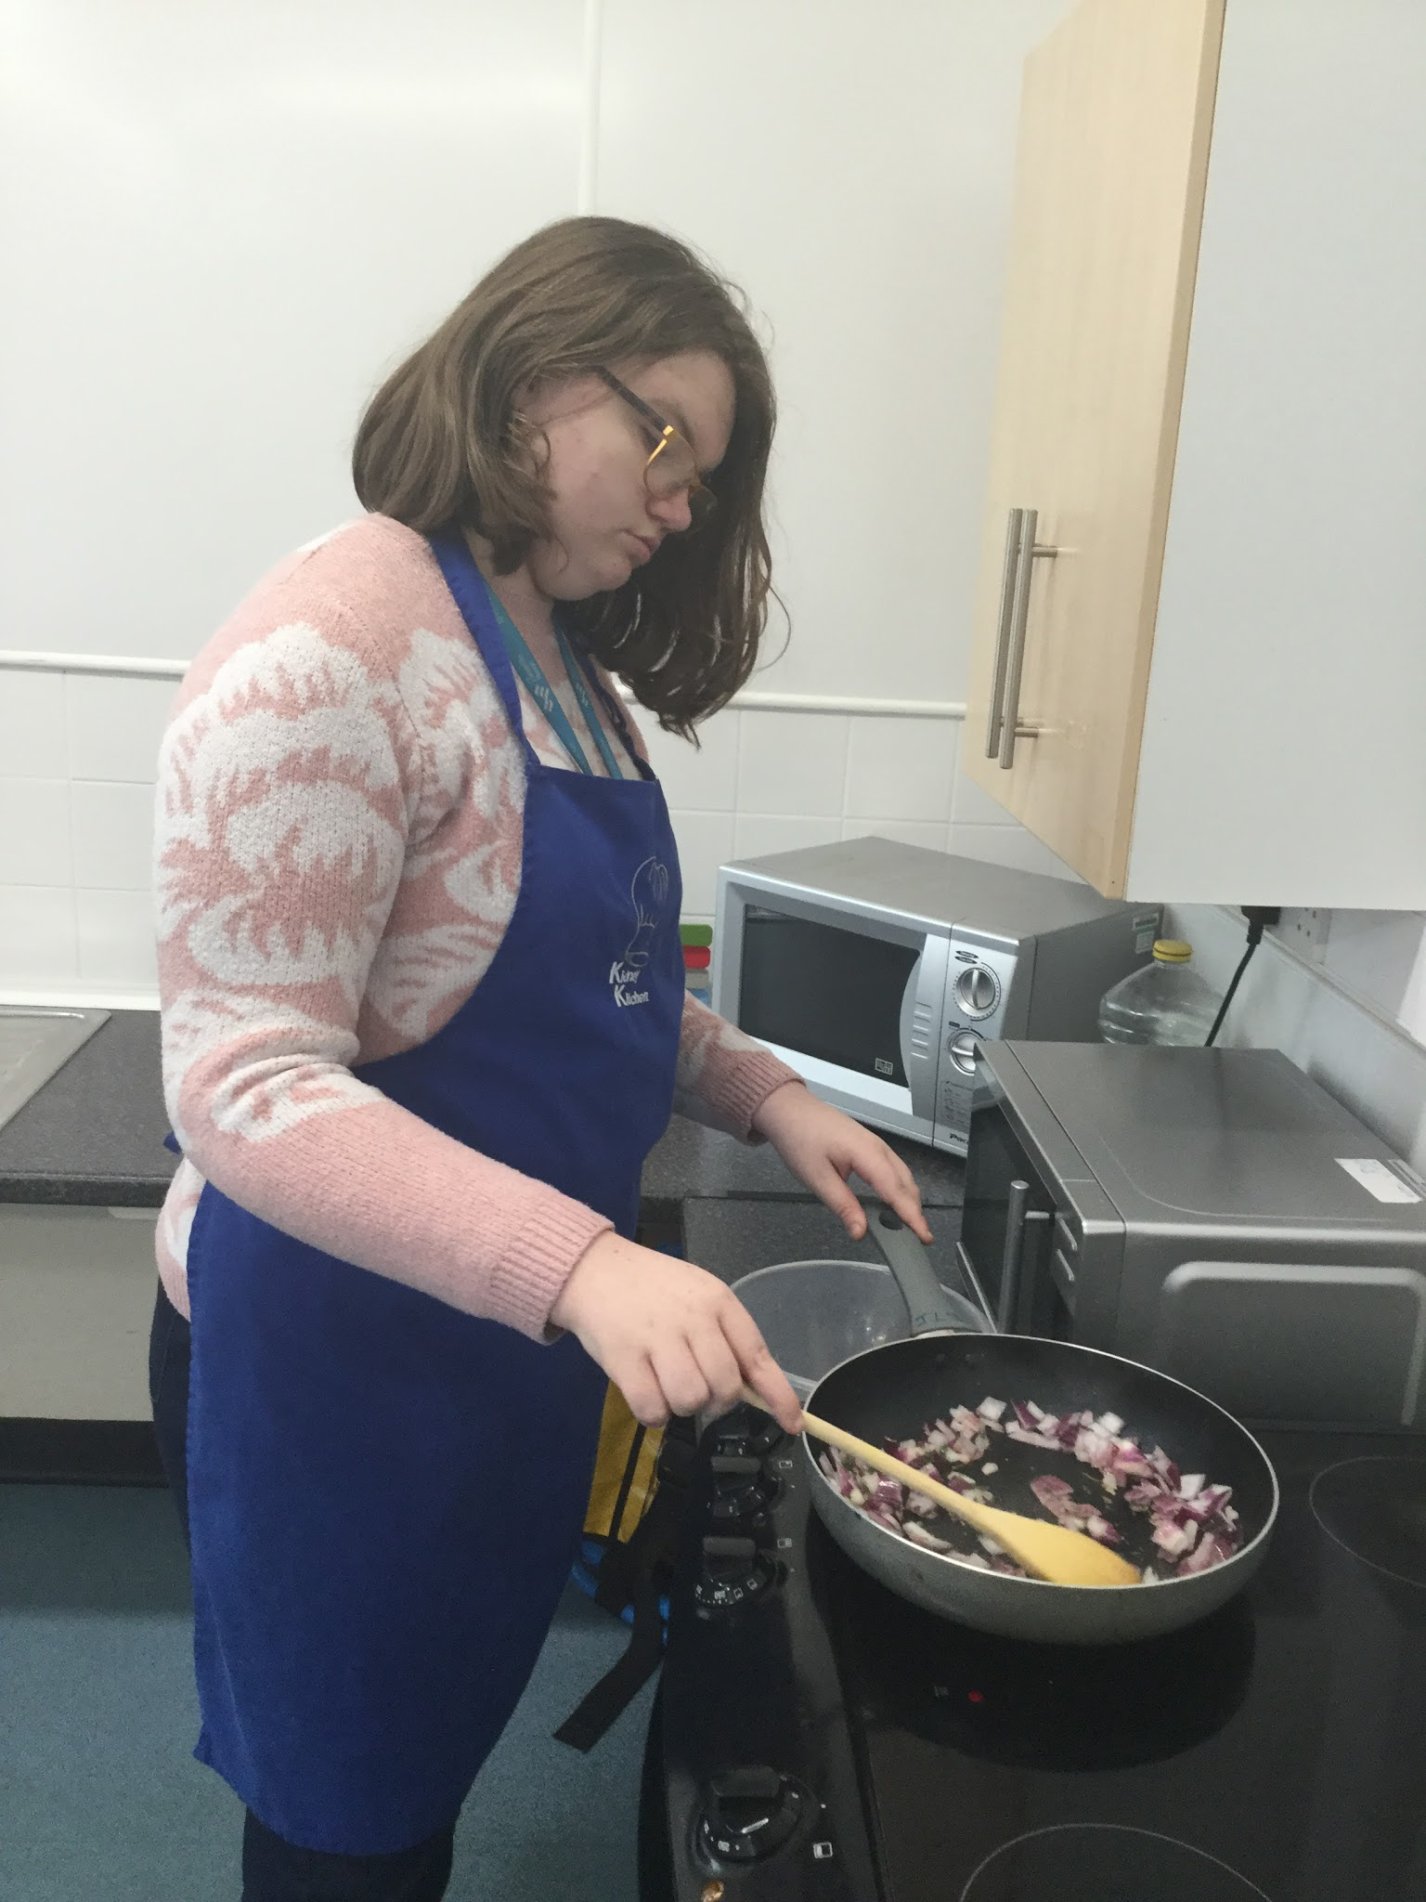
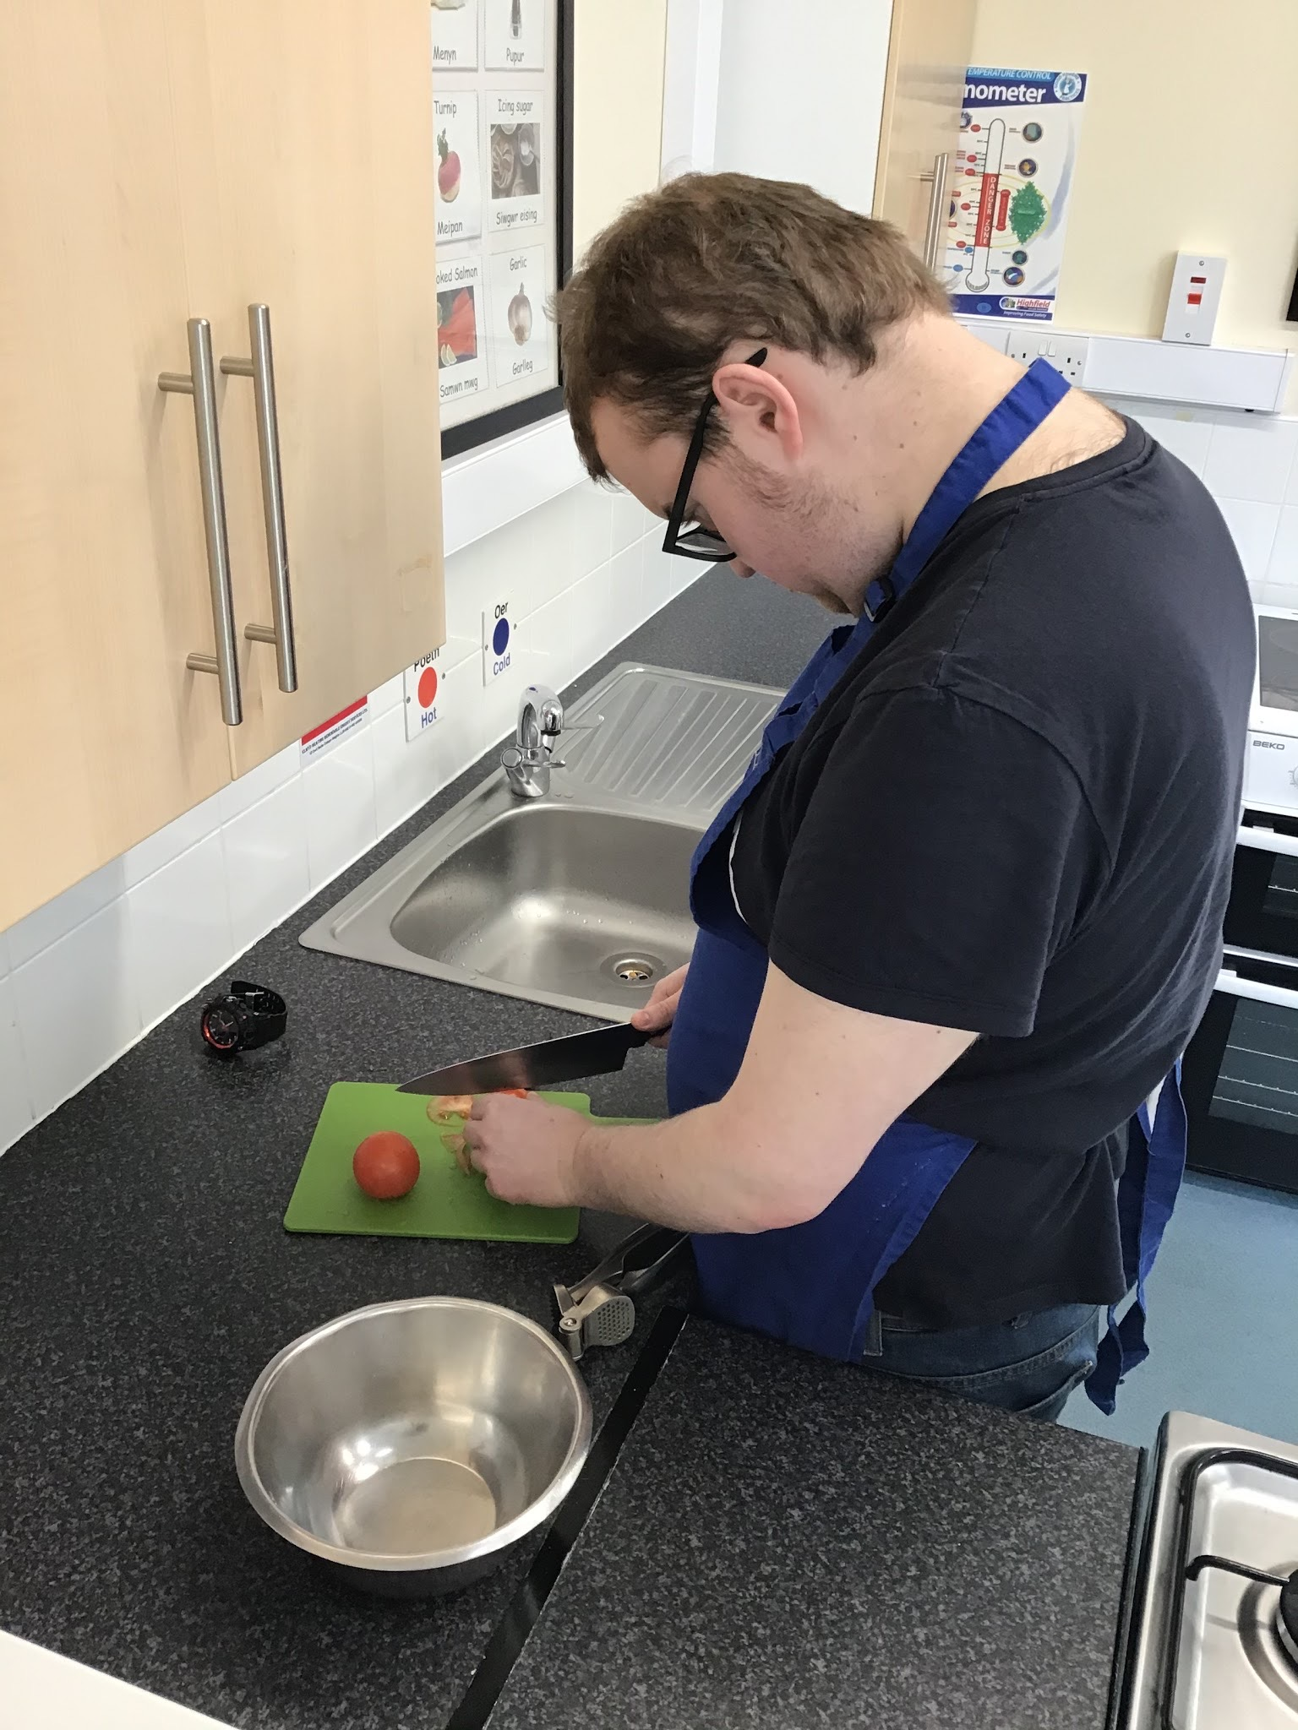
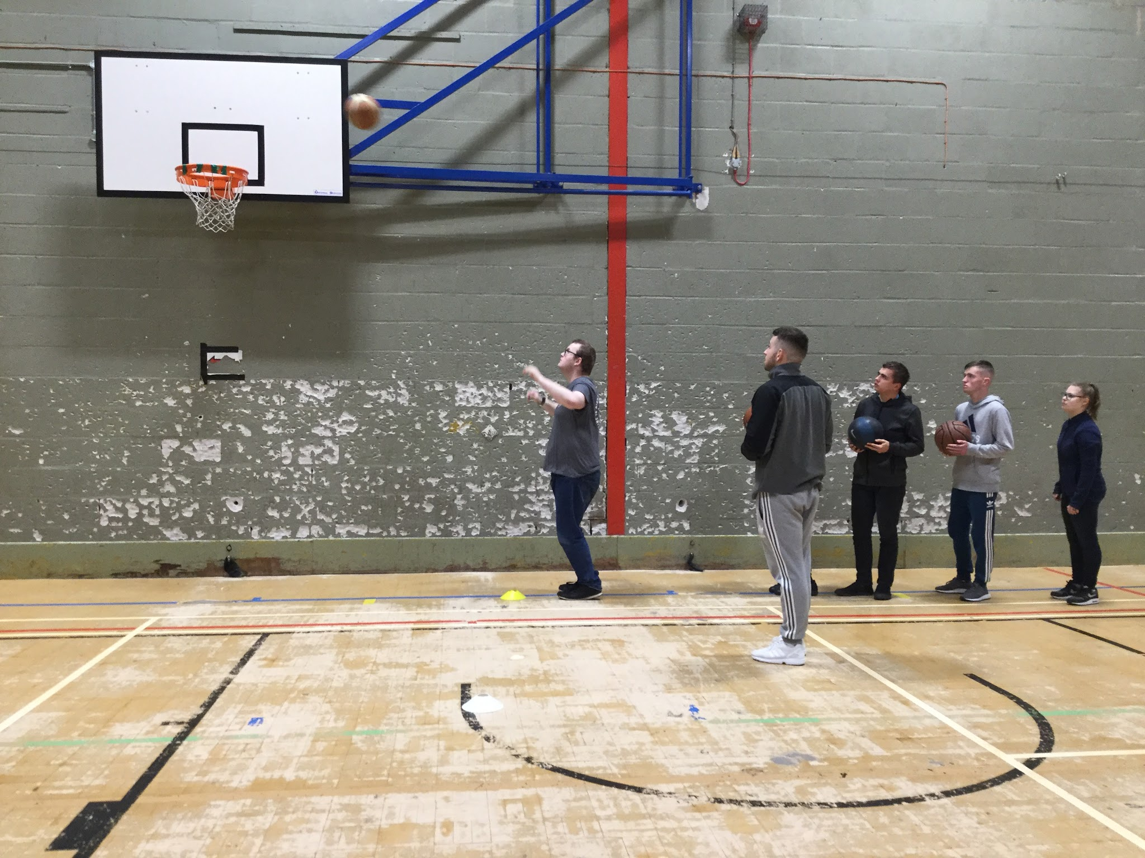
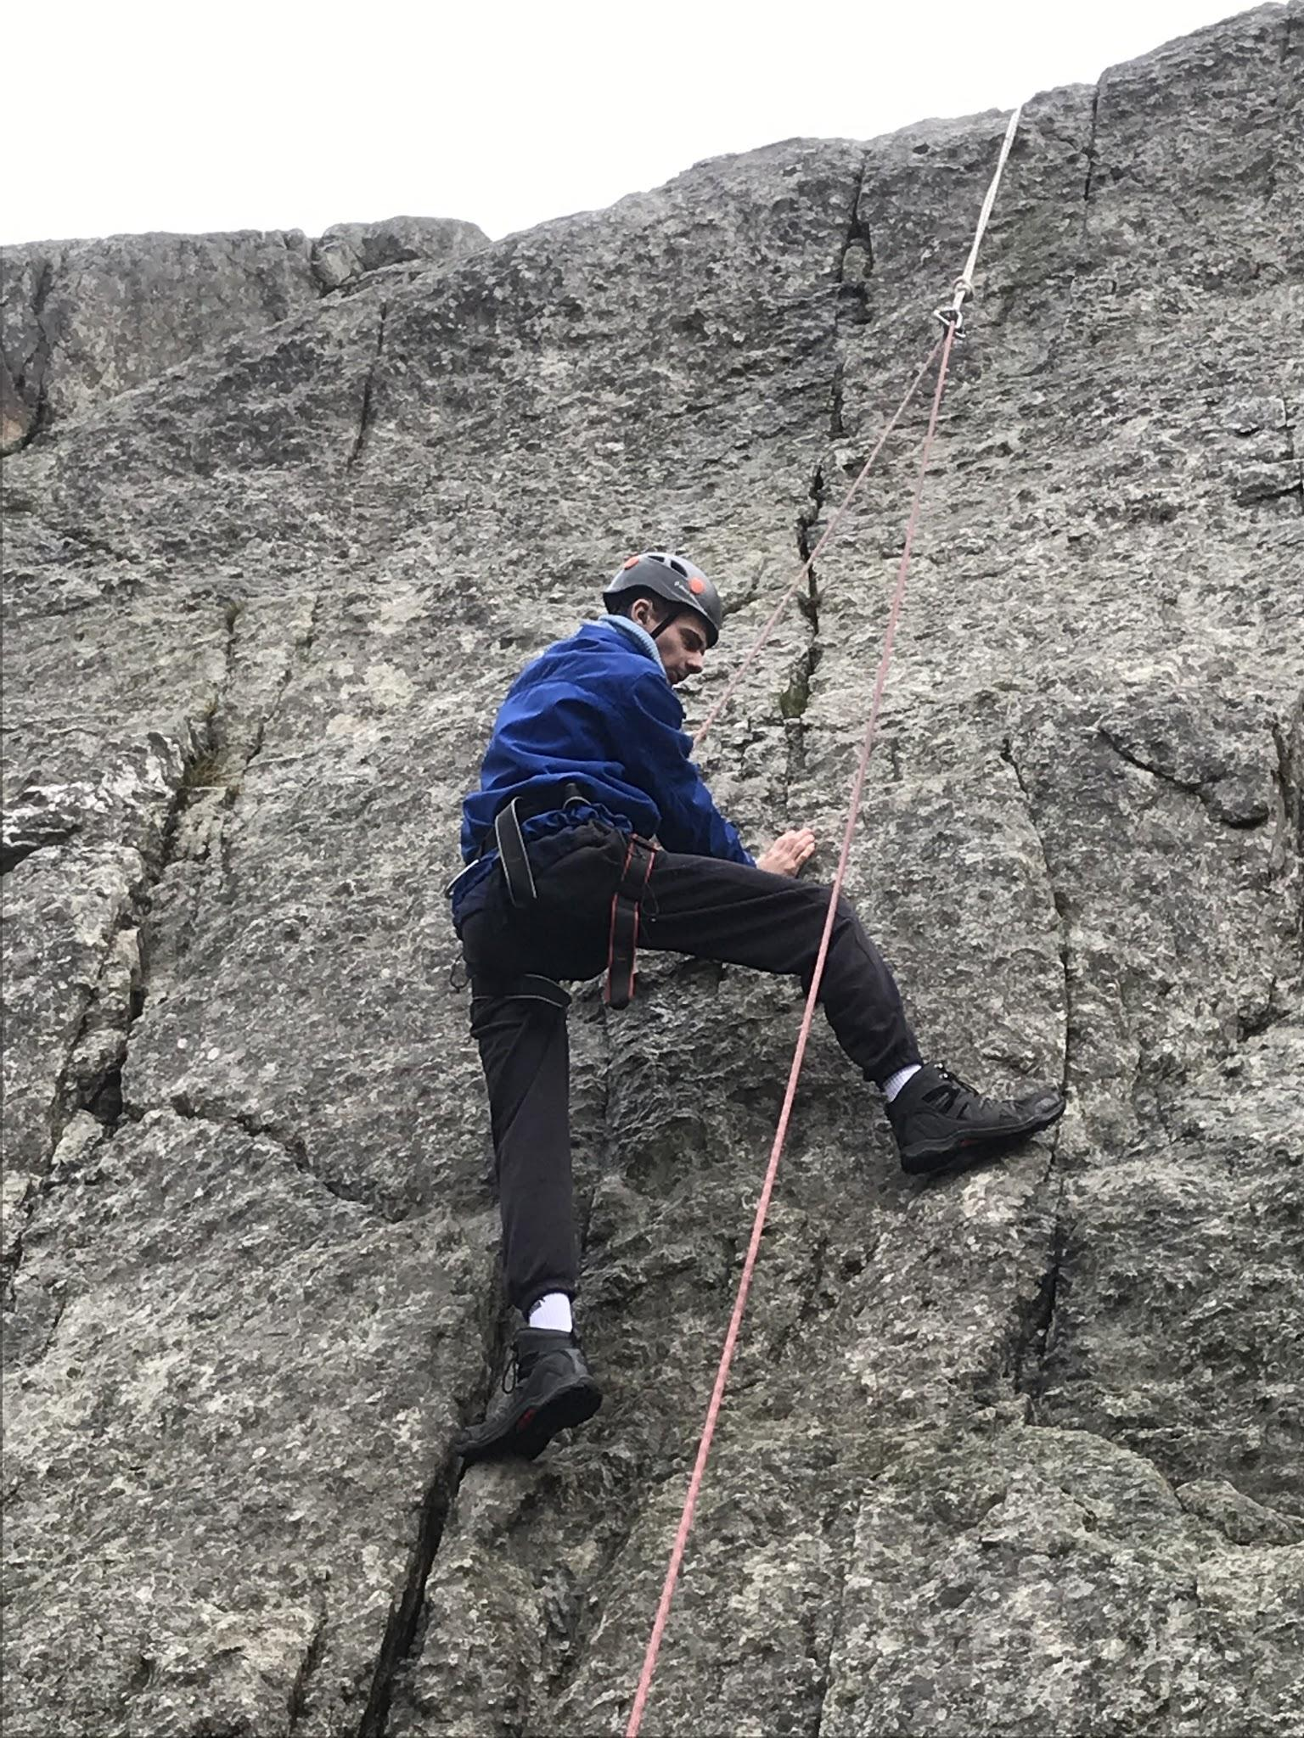
Pedwar Piler Sgiliau Byw'n Annibynnol
Caiff amserlen y dysgwyr ei threfnu ar sail y 'Pedwar Piler'. Caiff y rhain eu dangos isod gydag enghreifftiau :
Sgiliau Byw’n Annibynnol:
Iechyd a Lles:

Slide 6
The Four Pillars of ILS
Learners are timetabled around the ‘Four Pillars’, these are shown below with examples:
Independent Living Skills:
Health and Wellbeing:

Slide 7
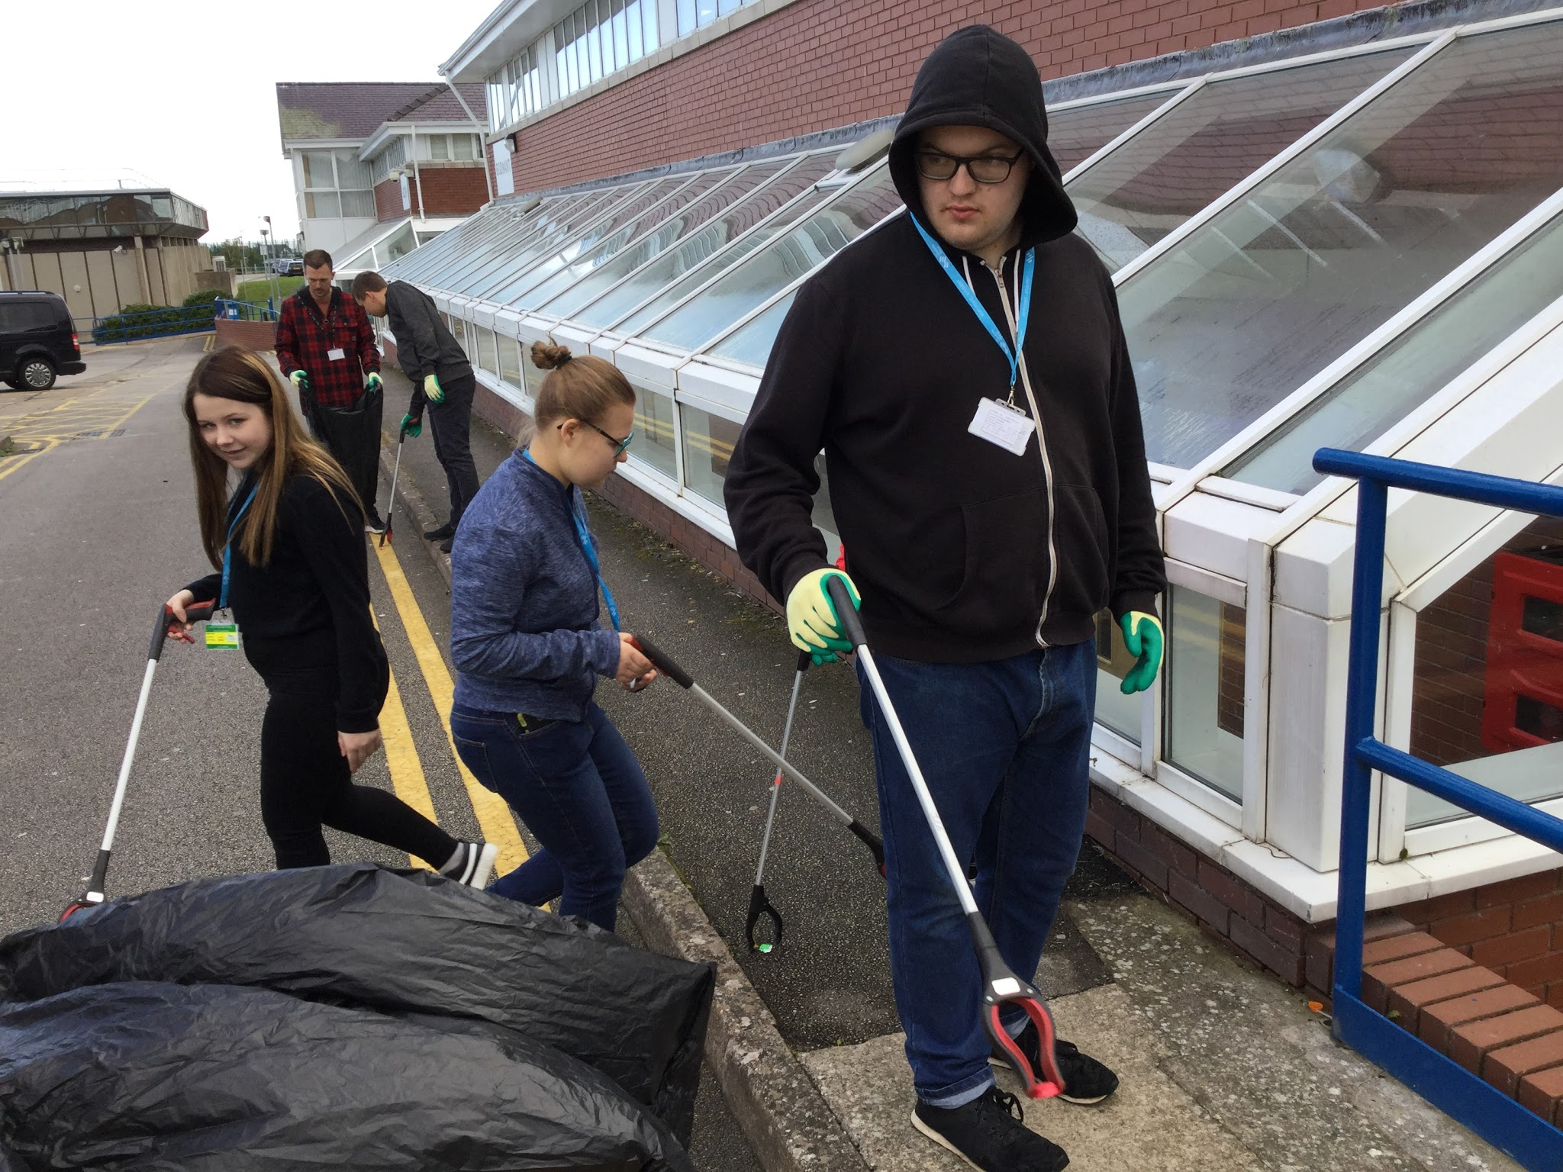
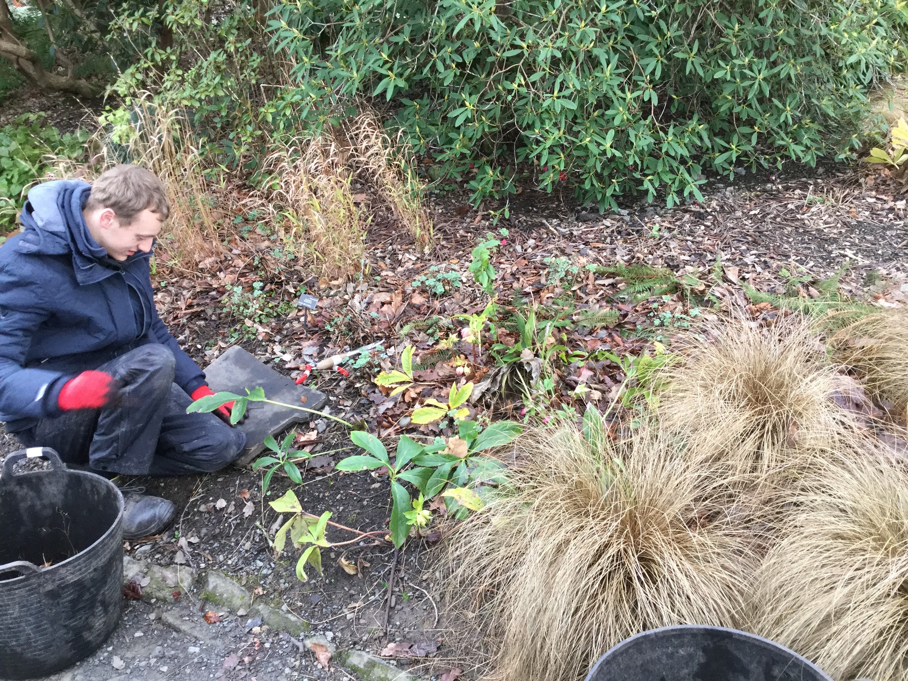
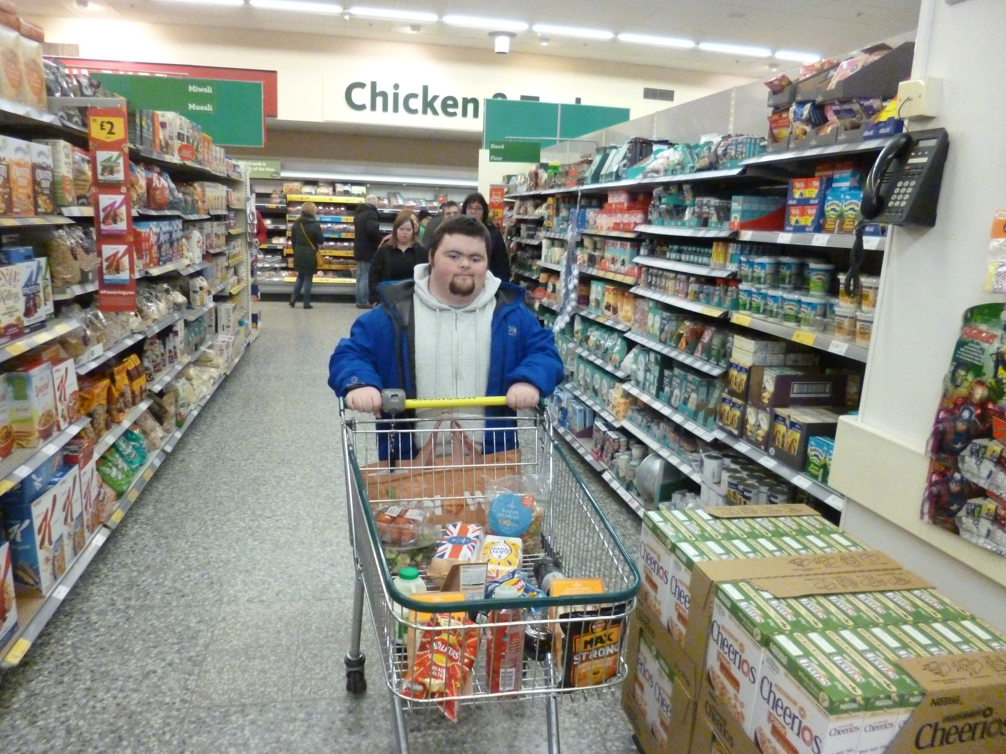
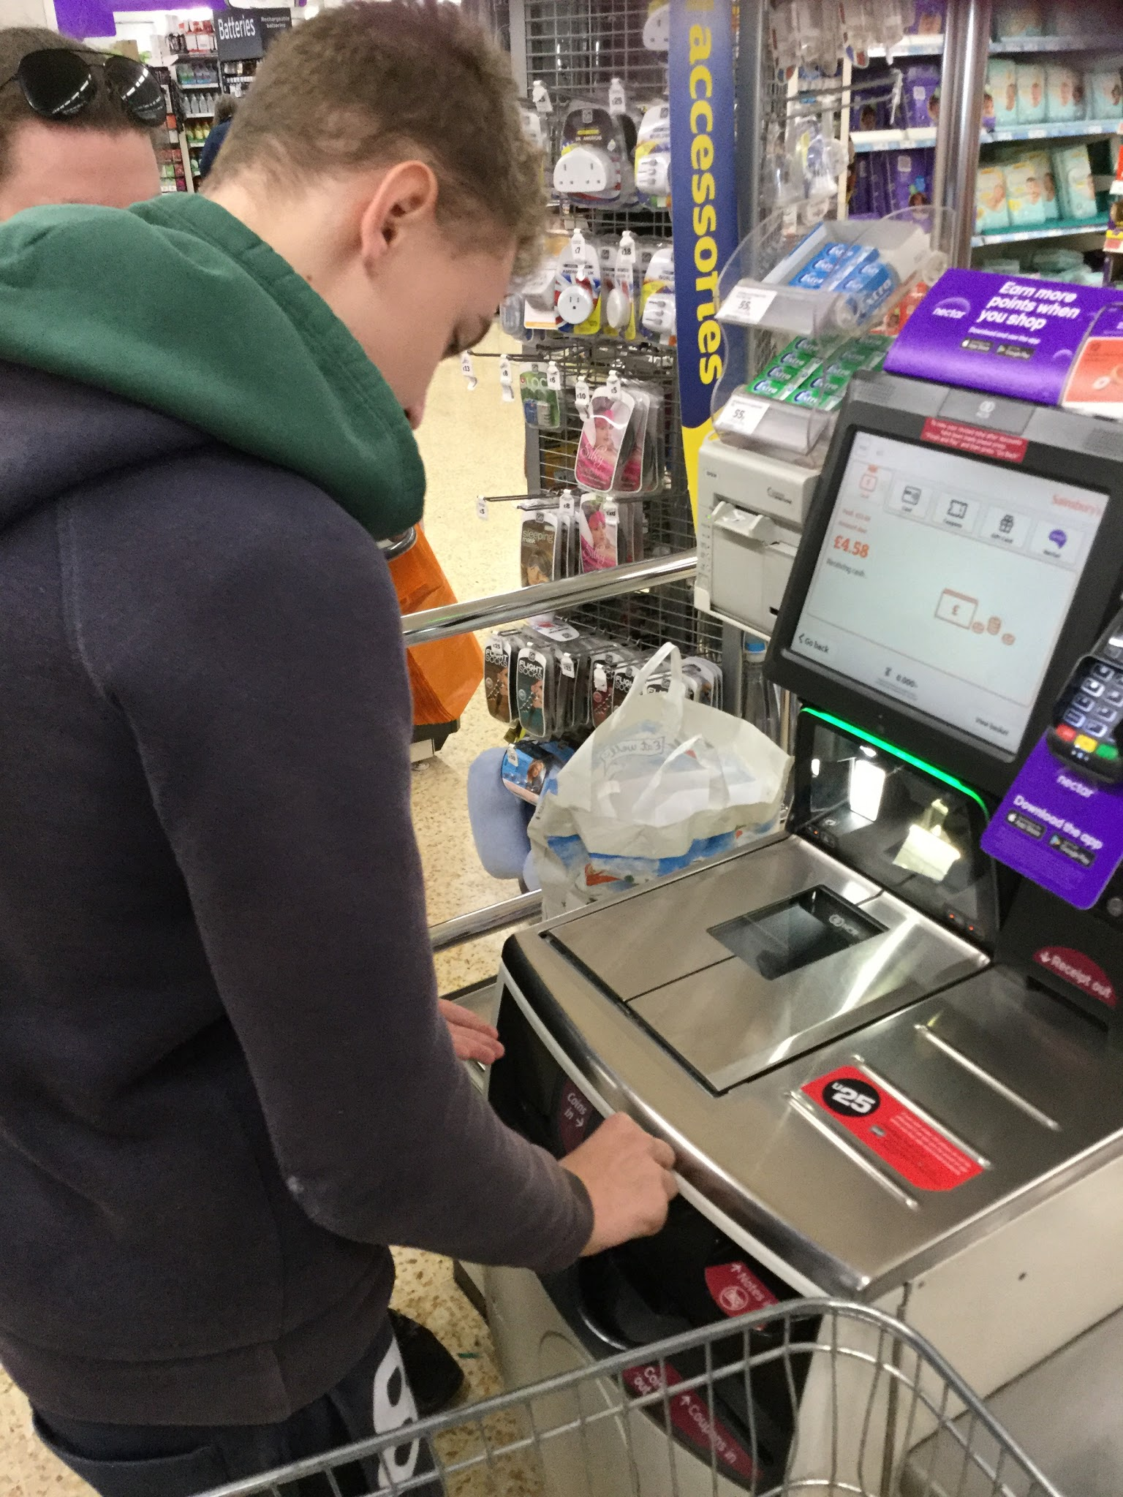
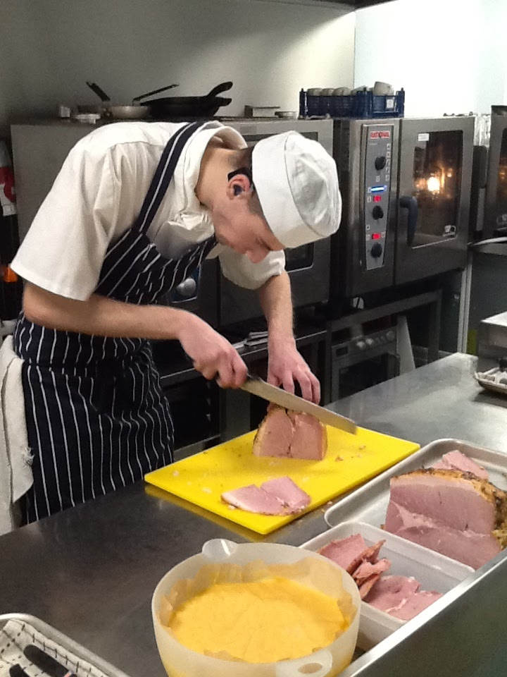
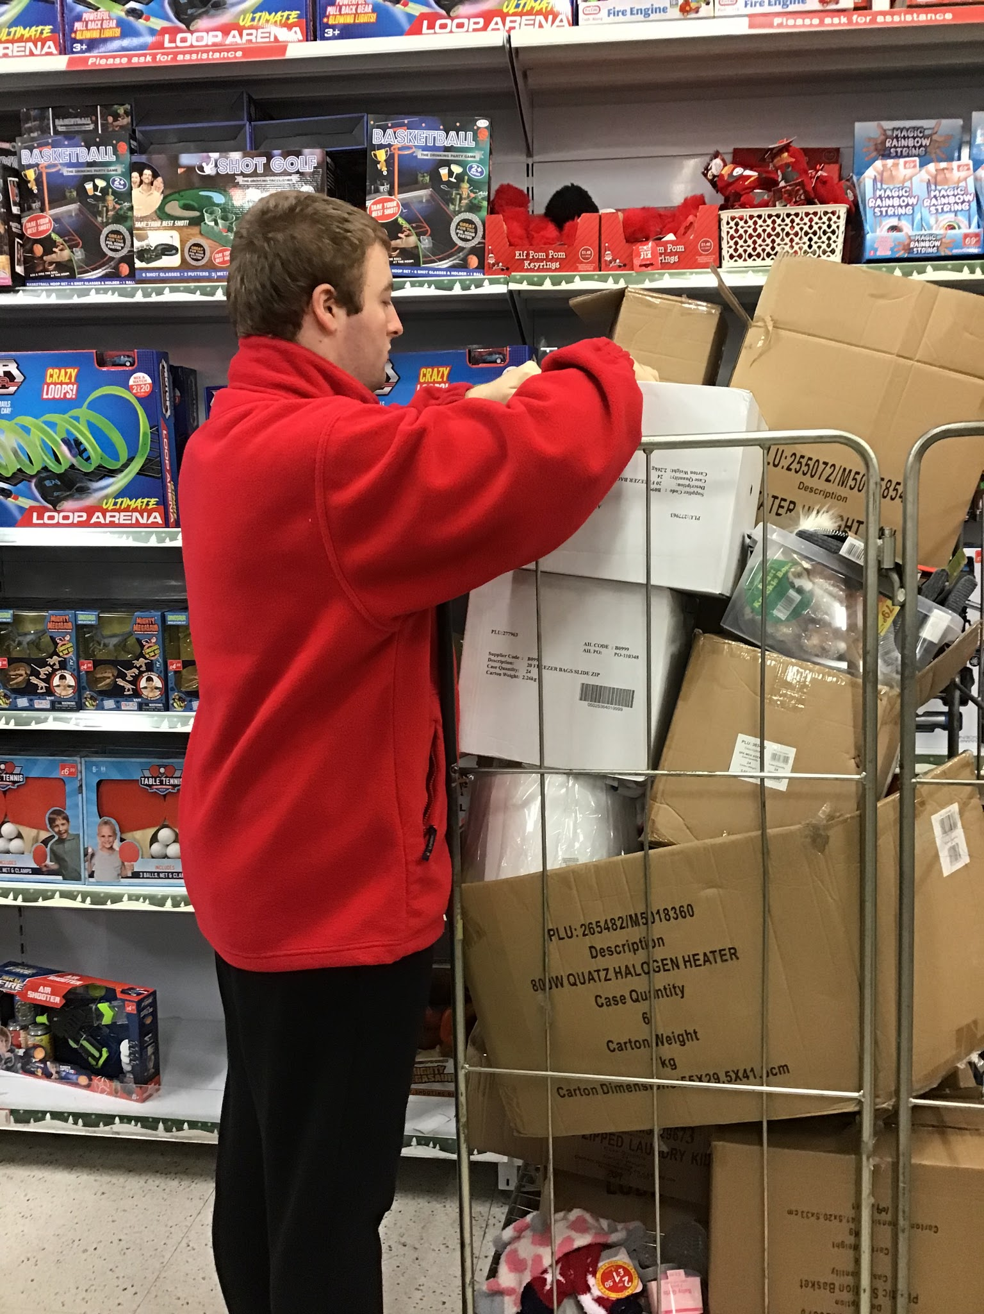
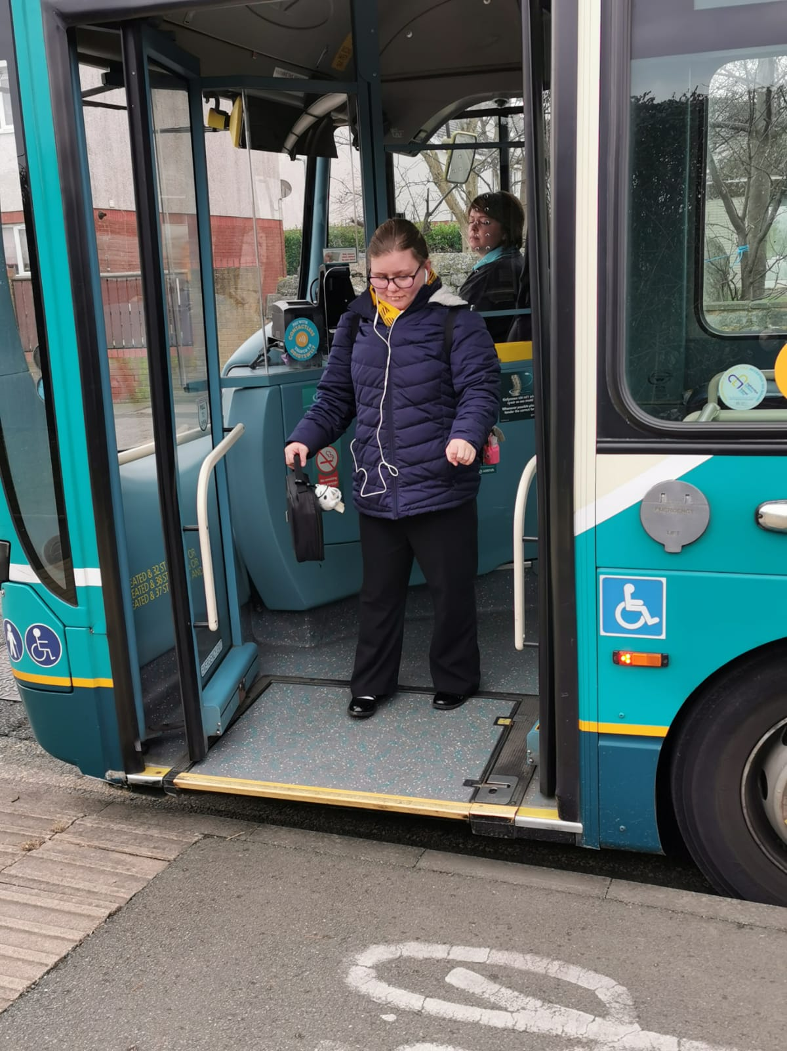
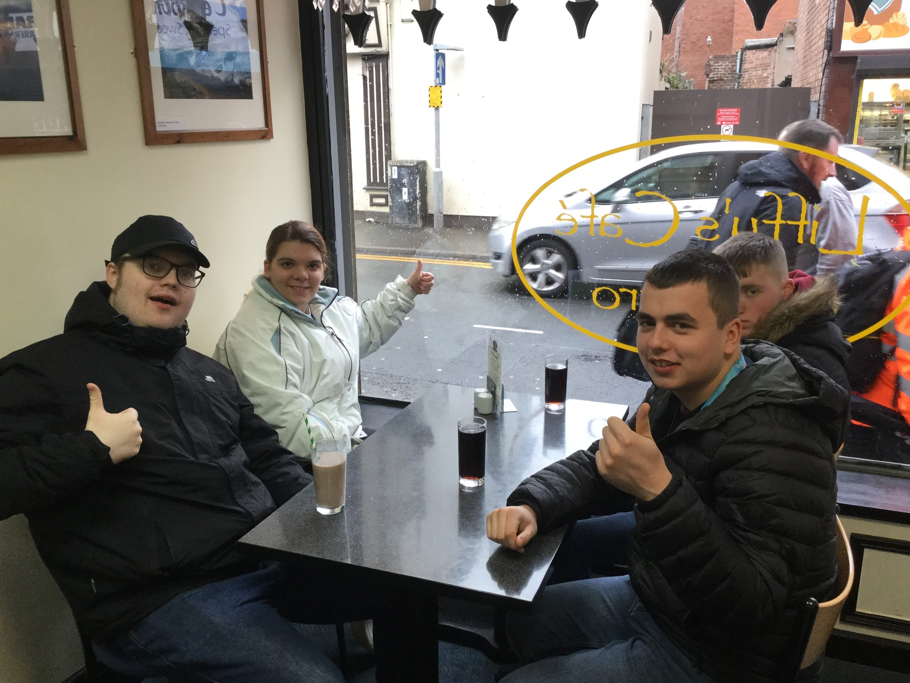
Sgiliau Gwaith / Cyflogaeth Mynediad i'r Gymuned

Slide 8
Work Skills / Employment Accessing the Community

Slide 9
Llythrennedd, Rhifedd a Llythrennedd Digidol
Sesiynau Adeiladu Sgiliau:
rhoi sgiliau llythrennedd, rhifedd a llythrennedd digidol i ddysgwyr.
yn cael eu hamserlennu; mae sgiliau llythrennedd, rhifedd a llythrennedd digidol hefyd wedi’u hymgorffori ledled y rhaglen.
yn cael eu teilwra, a’u cyflwyno i fodloni anghenion y dysgwr, a chefnogi dilyniant.
Gall rhai dysgwyr ennill cymwysterau Sgiliau Hanfodol, yn dibynnu ar gynnydd a chyflawniad.

Slide 10
Literacy, Numeracy, and Digital Literacy
Skillbuild sessions:
equip learners with literacy, numeracy, and digital literacy skills.
are timetabled; literacy, numeracy, and digital literacy skills are also embedded throughout the programme.
are tailored, and delivered to meet the needs of the learner, and support progression.
Some learners may gain Essential Skills qualifications, dependent on progress and achievement.

Slide 11
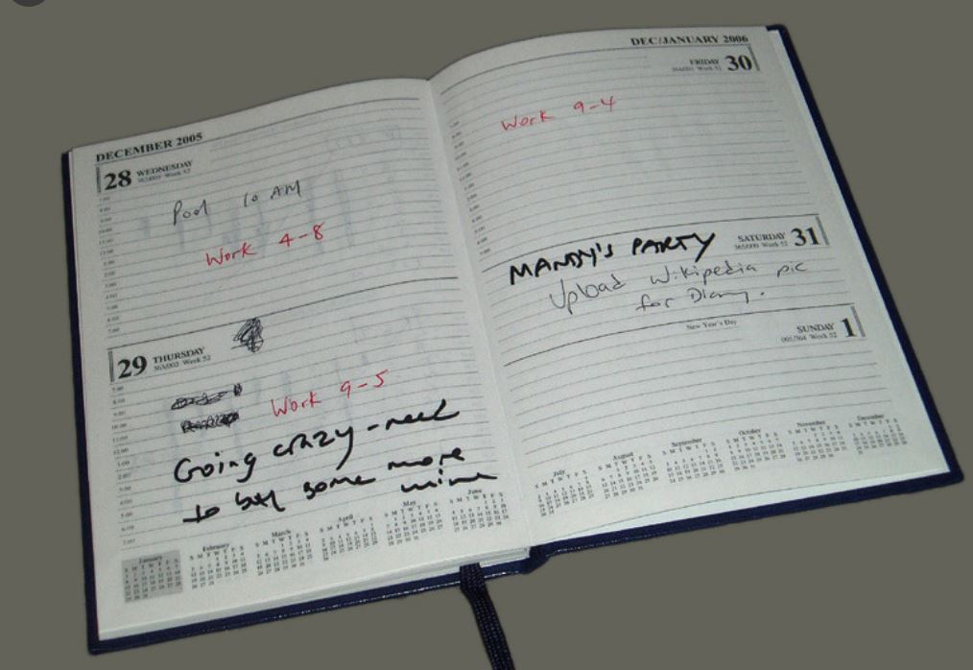
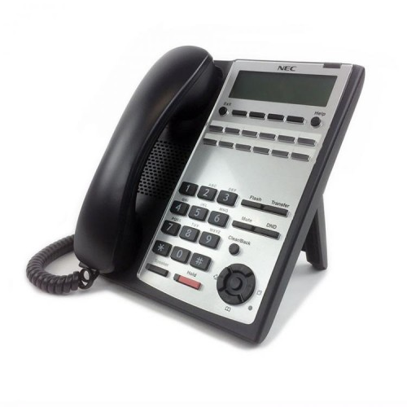
Cyfathrebu dwyffordd
Er mwyn manteisio i'r eithaf ar gyfnod yn y coleg, mae cyfathrebu dwyffordd rhyngoch chi a ni yn bwysig iawn. Weithiau byddwn yn anfon llythyrau ac e-bost felly gwiriwch yn rheolaidd. Ar rai cyrsiau mae gan ddysgwyr eu dyddiaduron eu hunain. Edrychwch ar y rhain yn ddyddiol oherwydd byddwn yn eu defnyddio i drosglwyddo gwybodaeth, nodiadau atgoffa a cheisiadau. Mae croeso i chi gysylltu â ni naill ai drwy e-bost neu dros y ffôn, a byddwn yn ymateb i chi cyn gynted â phosibl. Os oes newidiadau'n digwydd yn y cartref, pethau sy'n effeithio ar y dysgwyr, neu os ydynt yn poeni am unrhyw beth, cysylltwch â ni i roi gwybod. Os ydych chi angen siarad â rhywun ar frys, gofynnwch i'r dderbynfa eich cysylltu â'r adran SBA.

Slide 12
Two way communication
To get the very best out of college, effective two way communication between you and us is very important. Sometimes we will send out letters and email so please check regularly. On some courses learners have their own diaries so please do check these daily as we will pass on information, reminders and requests through these. We welcome you contacting us either by email or phone, and we will respond to you as quickly as possible. If there are changes at home, things that are affecting the learner, or if they are anxious or worried about anything, please do get in touch and let us know. If you urgently need to talk to someone ask reception to put you through to the ILS department.

